Slide 1


Hii,
Iam Siddhika
Welcome to Power BI Series
Part -42

Slide 2



Today Content
We focus only on the most used and important Dax Functions
I’m soo Excited.
Are you ready guys?
Meet DAX
COMMON FUNCTION CATEGORIES 6.DATE AND TIME FUNCTIONS CALENDAR
CALENDARAUTO
CALENDAR Vs CALENDARAUTO

Slide 3

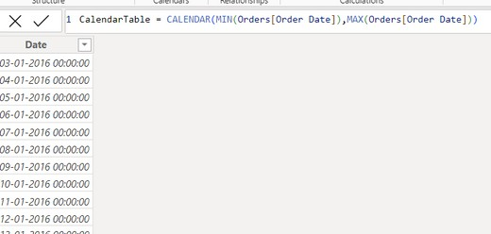
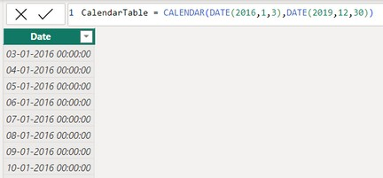

CALENDAR
CALENDAR function in DAX is used to generate a table of dates.
It requires a start date and an end date, and it will create a table with a single column containing all the dates between (and including) the start date and the end date.
Check next
Example also
Syntax
CALENDAR(<start_date>, <end_date>)
Example How can you create a calendar table from the earliest order date to the latest order date in your dataset?
Or
You can give dates manually
MIN(Orders[Order Date]): finds the earliest date in the Order Date column of the Orders table.
MAX(Orders[Order Date]): finds the latest date in the Order Date column of the Orders table.
CALENDAR(MIN(Orders[Order Date]), MAX(Orders[Order Date])): generates a calendar table with all dates from the earliest to the latest order date.

Slide 4
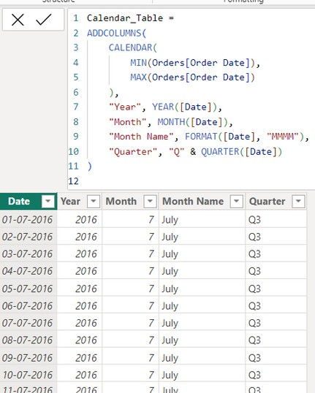


Another Example with More Columns
To make the CalendarTable more useful, you might want to add additional columns such as year, month, quarter, etc.
Easy?
ADDCOLUMNS function is used to add new columns to the table created by the CALENDAR function.
YEAR([Date]) Extracts the year from the date.
MONTH([Date]) Extracts the month number from the date.
FORMAT([Date], "MMMM")
Extracts the month name from the date.
"Q" & QUARTER([Date])
Extracts the quarter and formats it as "Q1", "Q2", etc

Slide 5

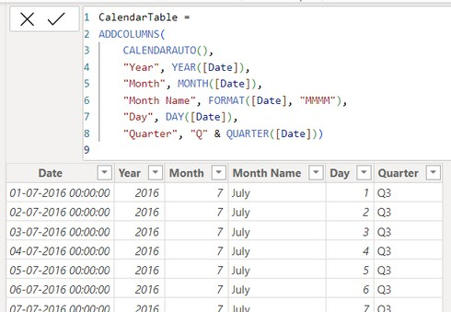
CALENDARAUTO
The CALENDARAUTO function in DAX is used to automatically generate a date table based on the data in your model. It scans all the date columns in the entire model to find the earliest and latest dates and creates a table with a single column containing all dates between those two dates.
Got it
Syntax
CALENDARAUTO([fiscal_year_end_month])
Let's create a calendar table for a dataset using CALENDARAUTO. We'll extend this example by adding additional columns for year, month, and day.
Example
How can you create a calendar table using CALENDARAUTO and add columns for year, month, day, and quarter?
CALENDARAUTO() generates a date table spanning from the earliest to the latest date in the model.
YEAR([Date]) Extracts the year from the date.
MONTH([Date]) Extracts the month number from the date.
FORMAT([Date], "MMMM") Extracts the month name from the date.
DAY([Date]) Extracts the day from the date.
"Q" & QUARTER([Date]) Extracts the quarter and formats it as "Q1", "Q2", etc.

Slide 6
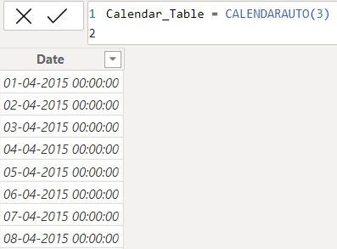
Another Example with Fiscal Year Ending in March
If your fiscal year ends in March, you can specify the fiscal year end month as 3
Got it
CALENDARAUTO(3)
specifies that the fiscal year ends in March. and starts From April.

Slide 7
CALENDAR
Vs CALENDARAUTO
Both CALENDAR and CALENDARAUTO are DAX functions used to generate date tables in Power BI, but they have different ways of determining the date range
Understood?
CALENDAR
CALENDARAUTO
Automatically determines the start and end dates based on the data in the model.
More flexible as it adapts to the date range in the data model.
Allows specifying a fiscal year end month, which adjusts the date range accordingly.
Generates a date table from a specified start date to a specified end date.
You have control over the exact range of dates.
Does not have built-in support for fiscal year end specification.

Slide 8


Thank you for joining me today to learn about Part -42 of Power BI!
Remember, Learning DAX is key to unlocking the full potential of Power BI for insightful reporting and visualization.
Stay tuned for more insights and tips on Power BI in our next Series.
Follow
Siddhika Shah

